Slide 1

CITY-WISE EXPLORATORY DATA ANALYSIS ON COLLEGE
BY :
B. BHARATH CHANDRA

Slide 2

Contents
Introduction
Problem statement
Web Scraping
Data Collection
Libraries used
Interface of Web site
Raw Data and Cleaned Data
Data Cleaning
Data Visualization
Scenarios
Conclusion
Challenges

Slide 3
Introduction:
Collegedunia is a website where we can find best colleges on different cities.
List of top colleges in India based on 2023 rankings.
City=[chennai,Hyderabad,Pune,Coimbatore,Bangalore,MumbaiBhopal,Jaipur,Lucknow,Thiruvananthapuram,Kolkata,Ahmedabad,Nagpur,Bhubaneswar,Indore,Guntur]

Slide 4
Problem Statement
Analyze and identify the engineering colleges in different cities with fee structure. Consider factors such as ratings, courses and student reviews.
Objective
Fee Analysis based on Cities, Reviews and Ratings.

Slide 5
WEB SCRAPING
Web Scraping is a technique to extract a large amount of data from several websites.
Web Scrapping extracts the data from websites in the unstructured format.

Slide 6





TOOLS(LIBRARIES)USED
Web Scarping Tools
Python
Google Chrome
Web driver
DATA CLEANING AND MANUPULATING
Numpy
Pandas
Regular Expression
DATA VISUALIZATION
Matplotlib
Seaborn
Plotly

Slide 7
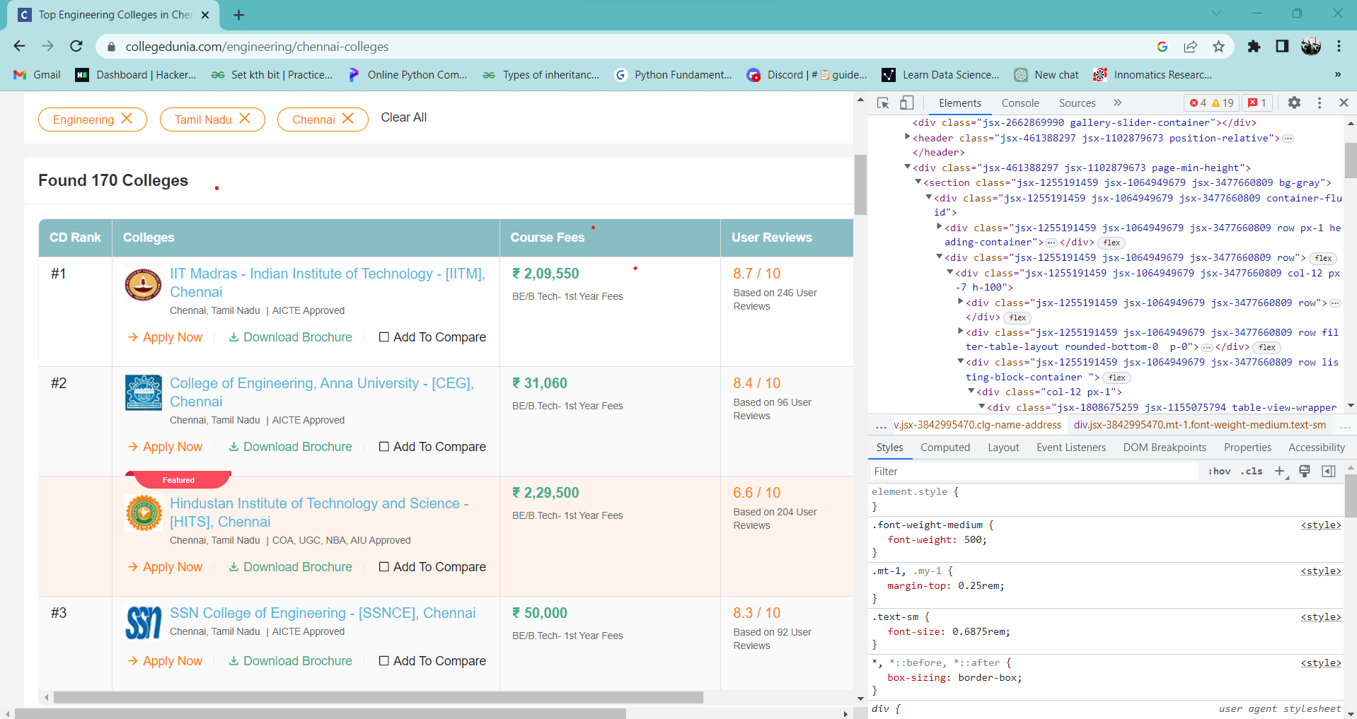
DATA COLLECTION
Collegedunia website has the information related to colleges
https://collegedunia.com/engineering-colleges
We used web driver, Requests together the data from the website.

Slide 8
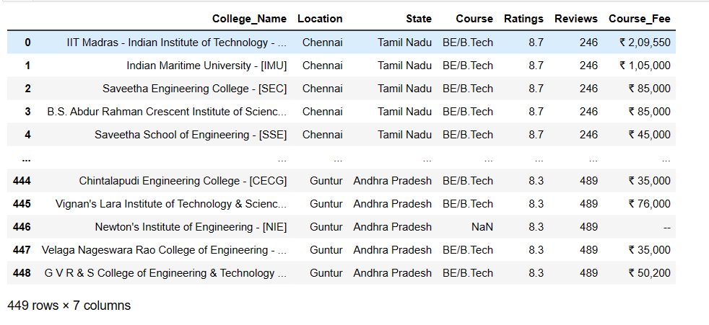
RAW DATA COLLECTION FROM COLLEGEDUNIA

Slide 9
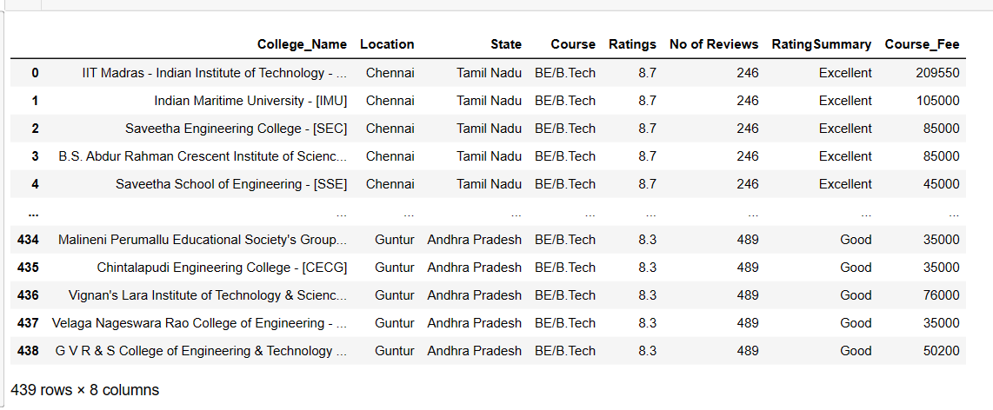
DATA CLEANING
Check for Duplicates.
Drop the duplicate column and unnecessary columns.
Checking and removing special characters.
Identifying and imputing missing values.
Data Type conversion.
CLEANED DATA

Slide 10
DATA VISUALIZATION
Univariate Analysis
UNIVARIATE ANYLYSIS:
Univariate data consists of only one variable. The analysis of univariate data is thus the simplest form of analysis since the information deals with only one quantity that changes.
BIVARIATE ANALYSIS:
Bivariate data involves two different variables. The analysis of this type of data deals with causes and relationships and the analysis is done to find out the relationship among the two variables.
MULTIVARIATE ANALYSIS
Multivariate analysis is required when more than two variables have to be analyzed simultaneously. It is a tremendously hard task for the human brain to visualize a relationship among 4 variables in a graph and thus multivariate analysis is used to study more complex sets of data.
Bivariate Analysis
Multi-variate Analysis

Slide 11
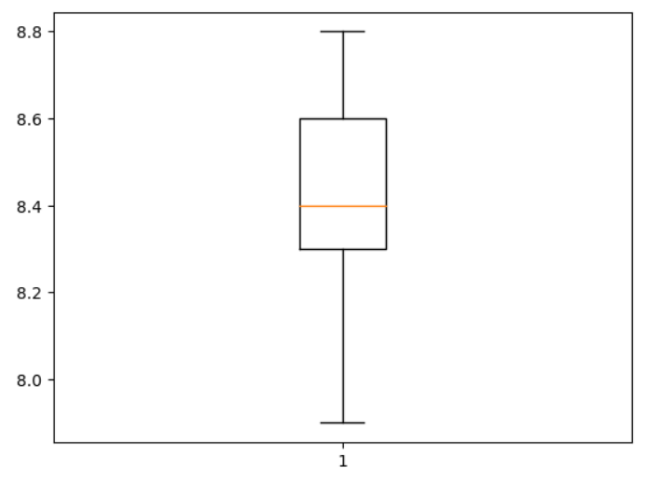
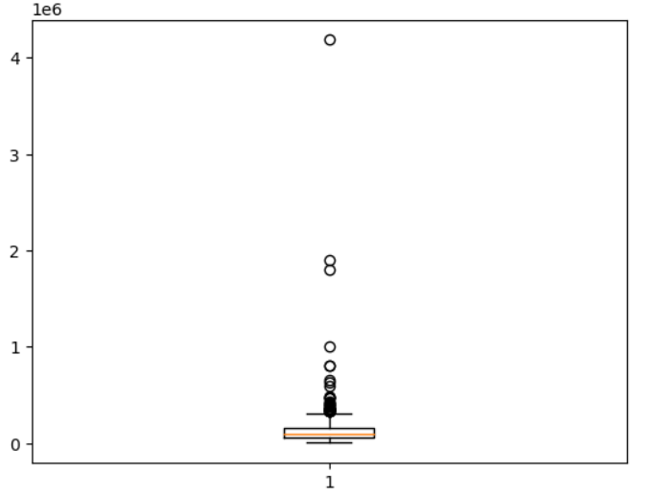
Outliers
Checking Outliers on Rating s and Course_Fee
Insights:
From the above boxplot, the Course_Fee column has more Outliers. However, it may be challenging to detect these outliers as the course fee can vary based on the reputation and demand of the course in different cities.
Ratings
Course_Fee

Slide 12
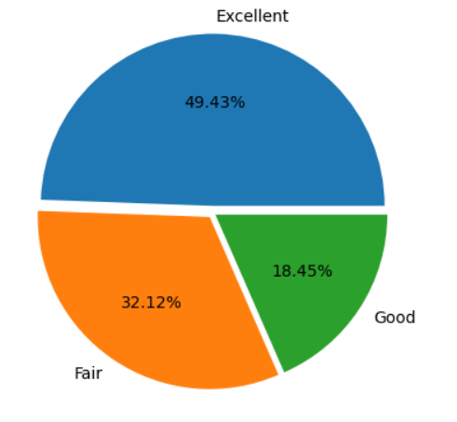
Analysis on the Rating summary using Pie chart
Insights:
The pie-chart clearly shows that most of the colleges are Excellent and followed by Fair and Few are Good

Slide 13
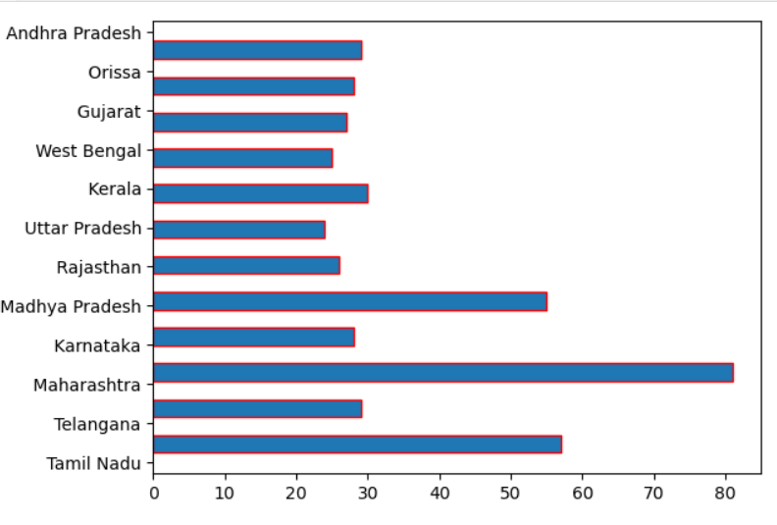
Analysis on college based on State
Insights:
From the above histo graph highest colleges are in Maharashtra, next highest are Tamil Nadu,Madhya Pradesh And lowest colleges in Uttar Pradesh and second lowest is Rajasthan, West Bengal

Slide 14
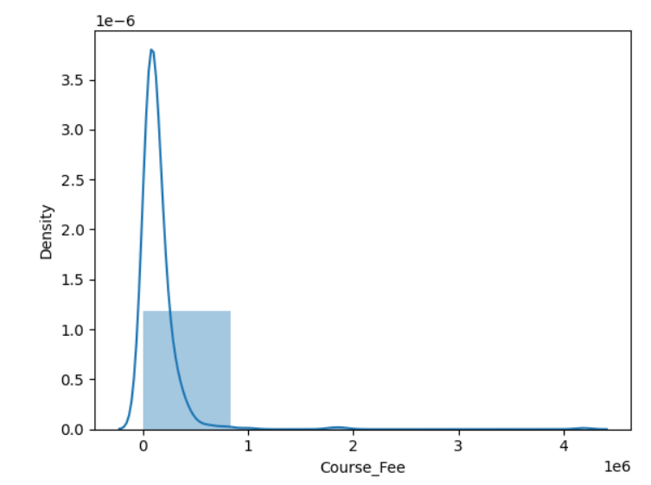
Analysis on Coure_Fee
Insights:
from the above density graph more number course_sfee is Distribute between of 1-10 lakhs.

Slide 15
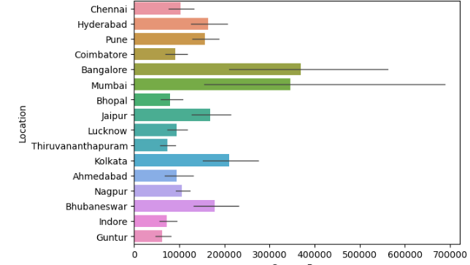
Insights: From the above bar plot Bangalore has high course_fee and Guntur has low course_fee.
Analysis on State and Course Fee

Slide 16
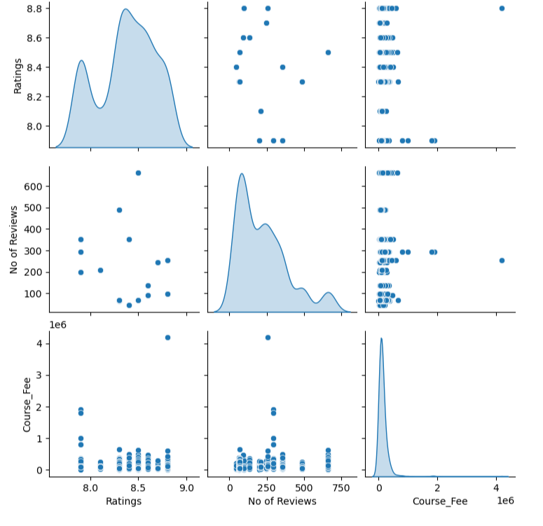
Analysis on as Course Fee, No of Review, Rating Using Pair plot
Pair plot:
To plot multiple pairwise bivariate distributions in a dataset, you can use the .pair plot function.
The diagonal plots are the univariate plots, and this displays the relationship for the (n, 2) combination of variables in a Data Frame as a matrix of plots.
Insights:
From the Pair plot we can describe completely. Numerical columns analysis
About Course Fee , No of review, Rating.

Slide 17
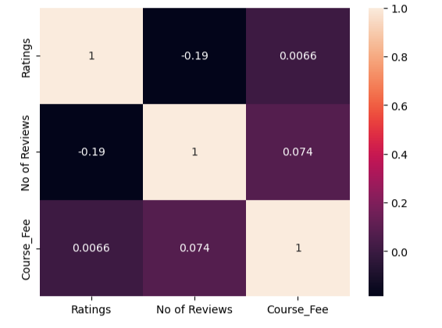
Insights: high positive co-relation between Course_fee and Reviews, negative co-relation between Reviews and Ratings.
Correlation distribution of Dataset of numerical columns using Heat Map

Slide 18
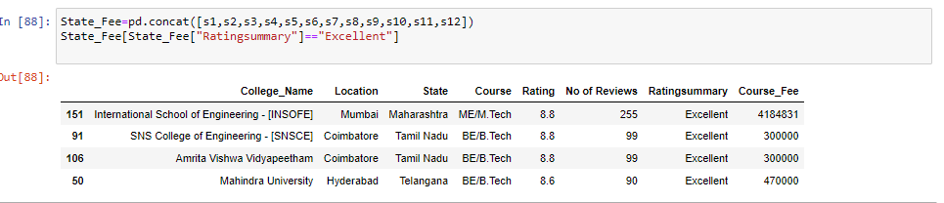
Scenario:
If the person wanted to join the good college with good Rating , then these are the colleges

Slide 19
CONCLUSION
Karnataka state charges high course fees between 3-4 lakhs, while Andhra Pradesh state charges very low course fees between 0-1 lakhs compared to other cities.
In India, 49.43% of engineering colleges are rated as excellent, 18% are rated as good, and 32% are rated as fair.
Most of the colleges in India are rated between 8.2 to 8.3.

Slide 20
Challenges Faced
Due to Dynamic Website While Dates Changed website URL is changed
Losing Data all the time, whenever we restart the kernel
We have got challenges that in same page html code was written in two type one is take as odd and even , due this issue we need to taken odd container and even container, To get complete data from website
.

Slide 21

THANK YOU

